Slide 1
Optimal Location for Opening an Indian Restaurant in Toronto
IBM Data Science Professional Certification
Himanshu Bhalani

Slide 2
Problem
While opening a restaurant can be a very lucrative business, a lack of demand causes many restaurants to close within the first year of opening
Factors for Restaurant’s Success: Location, Competition, Quality of Food
Business Problem: If the client wanted to open an Indian Restaurant in Toronto, what areas are the best options to open the restaurant?

Slide 3
Data
Data Sources:
Foursquare API
Toronto Census
Population & Ethnic Distribution of Each Neighborhood (Toronto Census)
Income Distribution of Each Neighborhood (Toronto Census)
Number of Restaurants in Each Neighborhood (Foursquare API)
Number of Indian Restaurants in Each Neighborhood (Foursquare API)
Latitude and Longitude of Each Neighborhood

Slide 4
Problem

Slide 5
Foursqaure API
Cluster 0 = Red Cluster 1 = Purple Cluster 2 = Blue Cluster 3 = Turquoise Cluster 4 = Orange

Slide 6
Cluster | Characteristics
Cluster 0 | Positive Spending Power (0.3 – 1.8)
Cluster 1 | Negative Spending Power (-1.2 -- -0.8)
Cluster 2 | Near Zero Spending Power (-0.5 – 0.5)
Cluster 3 | High Positive Spending Power (1.7+)
Cluster 4 | Negative Spending Power (-0.8 – 0) With Large Number of Restaurants

Slide 7
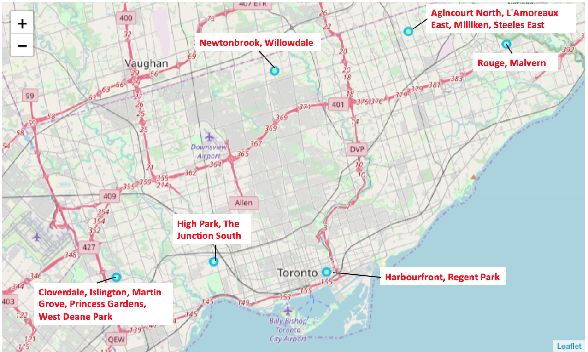

Slide 8
From the plot, the following areas can be eliminated due to the large number of areas:
Agincourt North, L’Amoreaux East, Milliken, Steeles East
Newtonbrook, Willowdale
Harbourfront, Regent Park

Slide 10
The population of each region is relatively the same.

Slide 11
Conclusion
The optimal location to open an Indian restaurant in Toronto, Canada would be the Rouge, Malvern area.

Slide 12
Thank you!

